Slide 1
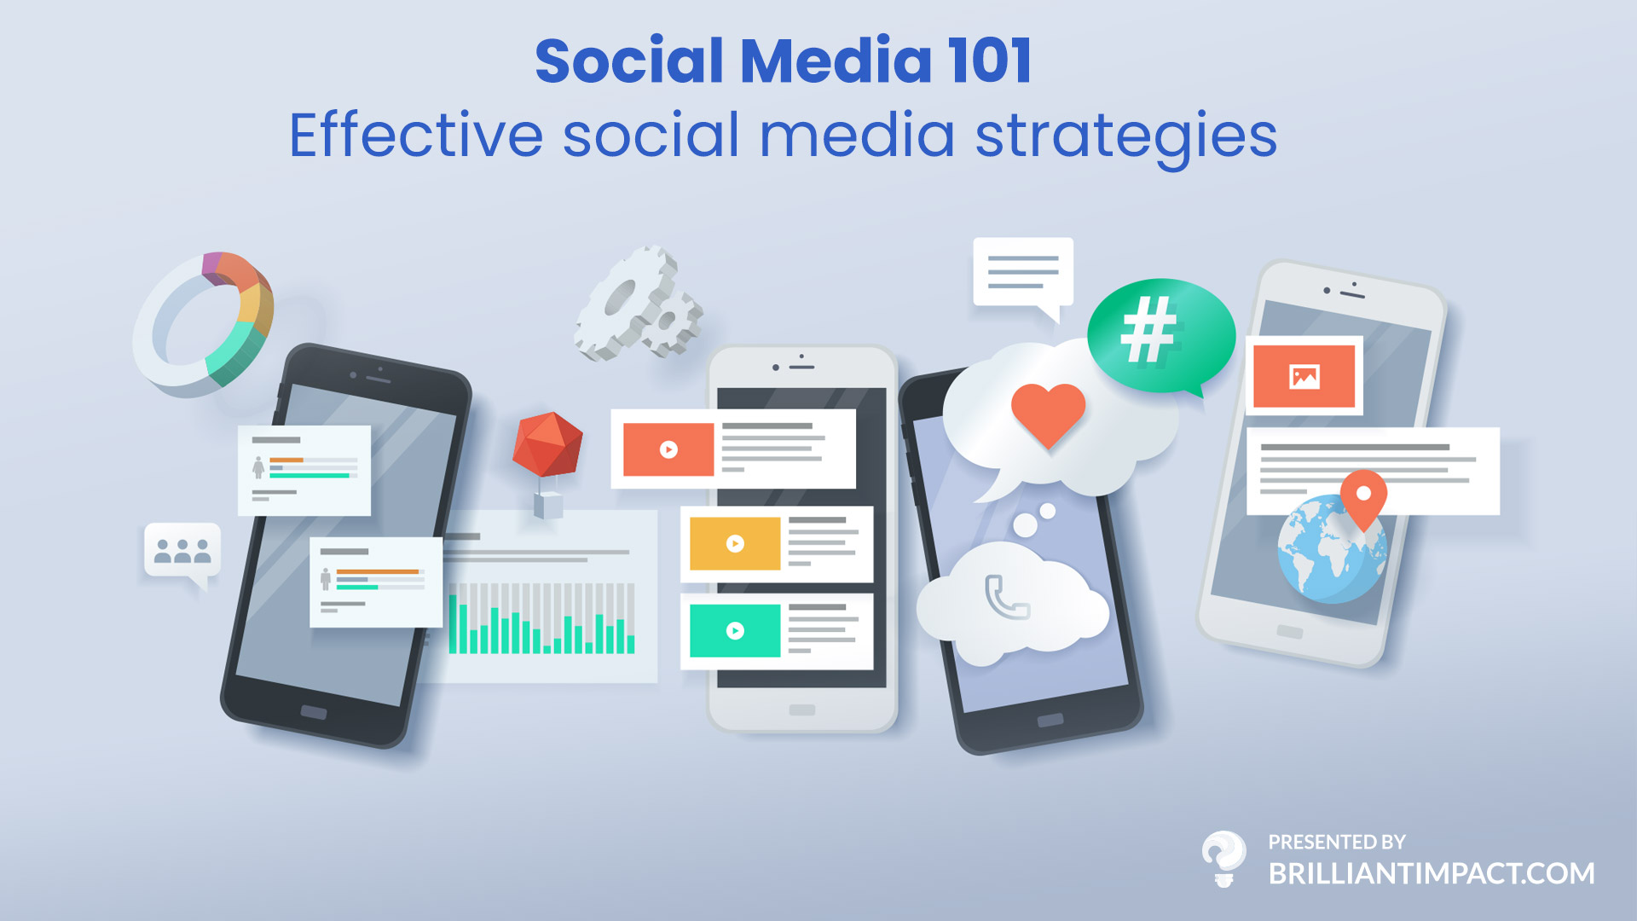

Slide 2
About Brilliant Impact
Live and Work in River Falls, Wi
Started in 2007, we have over 10 years of experience with online marketing
Specialize in custom marketing to grow our clients businesses
We help create: Video, Photos, Content and Websites

Slide 3
Social Networking Basics
An online networking architecture that is designed for interacting with a community of users.
Basic foundations of social sites
Profile or Page – information about the user, what you like, what you do, informs users of common interests
Posts – Original Content, an image, short video, external links designed to inform followers about what you are doing.
Followers or Friends – People you know, or have an interest in your content.
Sharing – Someone else's content, photos, videos, and information.
Stories – Small daily updates that expire after 24 hours

Slide 4
Why use social media for business?
Gather Intelligence - People are always discussing products, services, brands and companies, join the discussion!
Increase Website Traffic and Revenue – Grow your leads and turn them into revenue
Build Trust and Credibility – Build personal relationships with loyal customers and potential clients
Target Accurately - Ability to narrowly target your audience and demographic across the globe

Slide 5
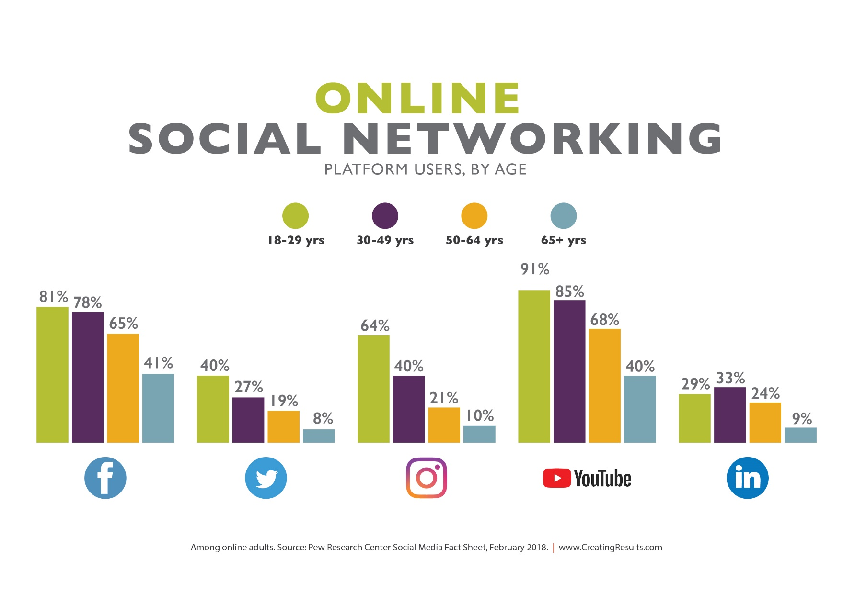
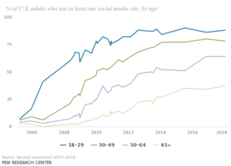
Social Media use is growing in all age groups

Slide 6
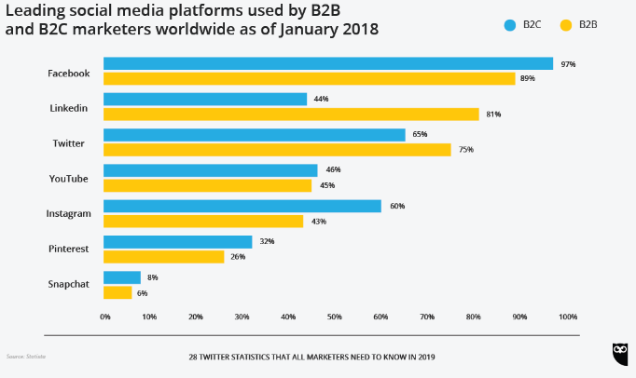
Leading Social Media Platforms

Slide 7
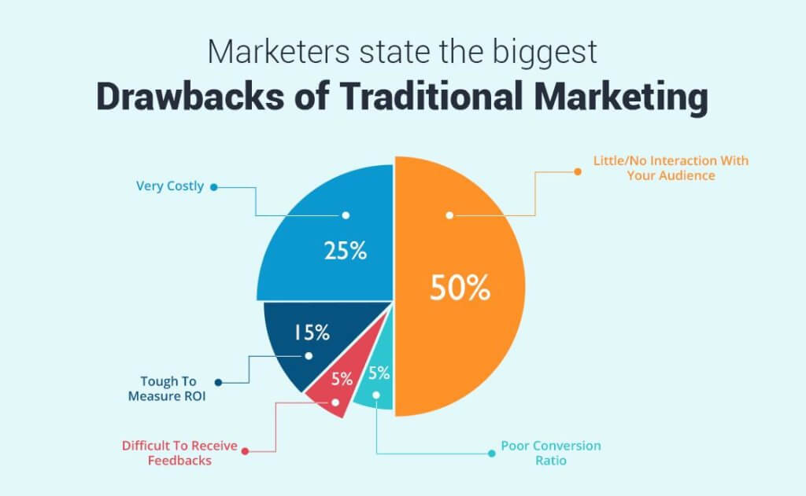
What about traditional media?
Offline traditional media TV, radio, print ads
Is in serious decline with millennials
Works well together with social media
Social media now drives traditional news

Slide 8
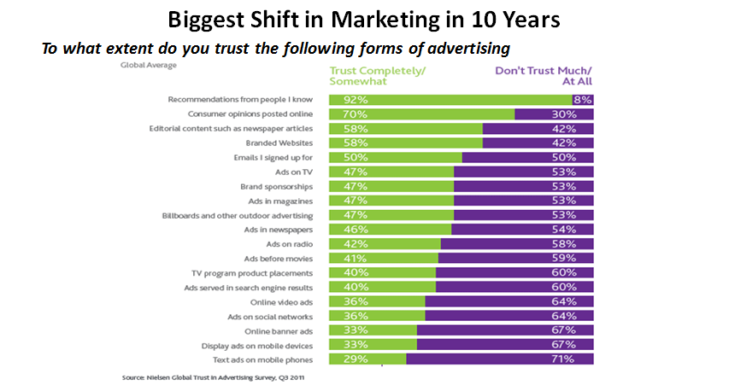
Degree of trust in advertising
#1 - 92% from people known
#2 – 70% consumer opinions posted online

Slide 9
What Network is right for your business?
Facebook
Instagram
Twitter
YouTube
Linked In
Pinterest
Snapchat

Slide 10
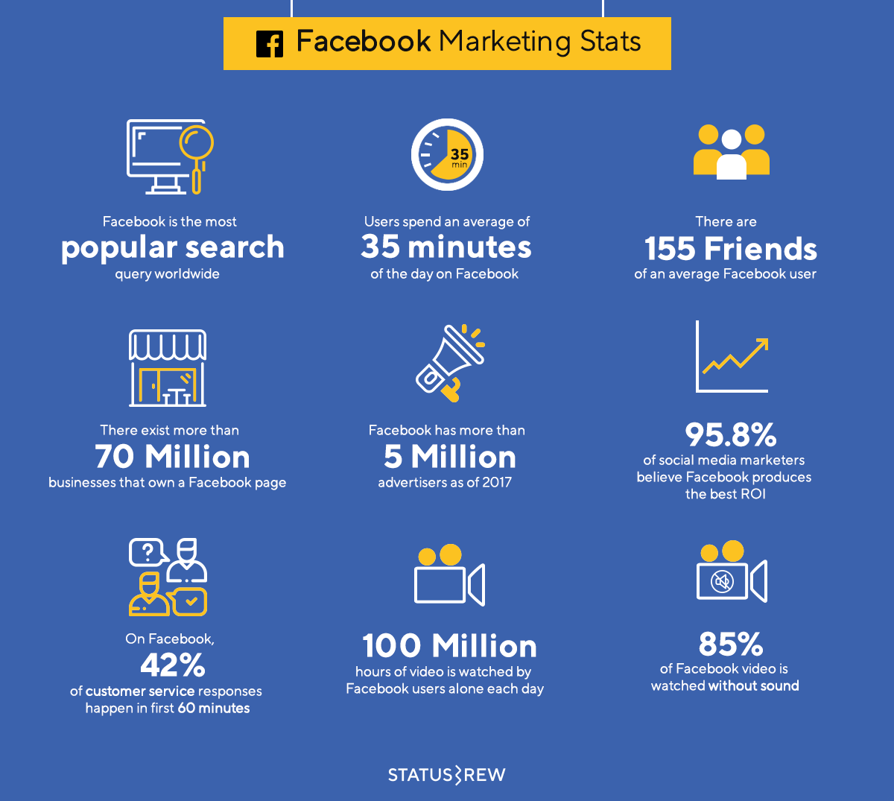
Facebook, the giant in the room (2.27bn users)
Notes:
Originally created for college students
Relies on profiles and users interacting in discussions.
Sharing
Picture Albums
Videos
Links
Status updates
50% log in every day
500 million + users
150 million are mobile

Slide 11
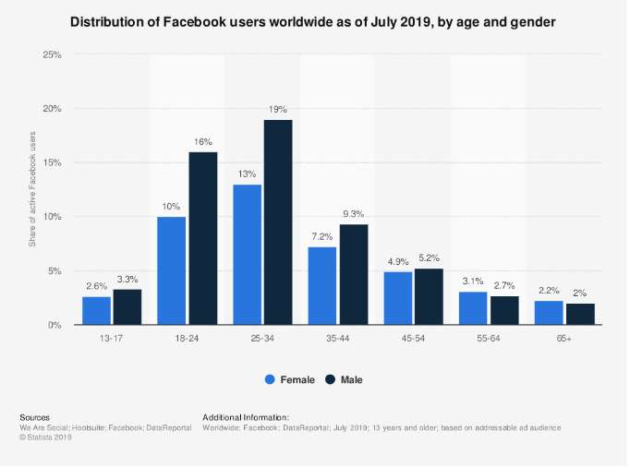
Facebook User Break Down
By far the top performer in Social Media across all ages
Ability to reach and target specific demographics
Easily track user engagement and see results

Slide 12
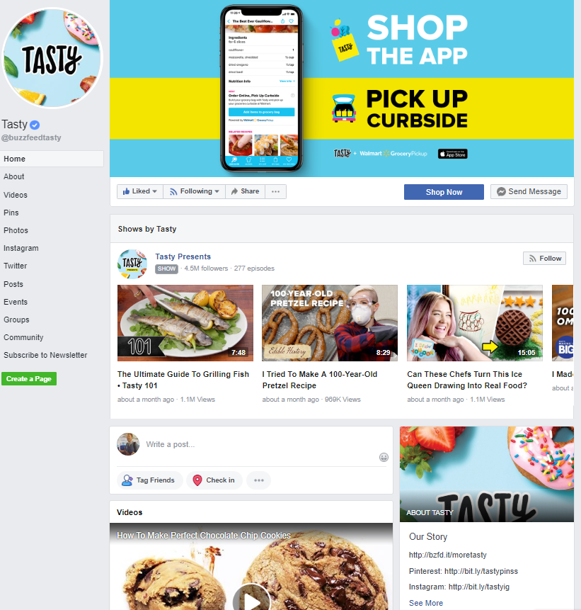
Facebook Feature
Tasty
97 Million+ likes
1.6 billion of it’s 1.8 billion views come from facebook
Call to Action in the cover photo and action buttons
Highlighting video show
Facebook automatically highlights user video and photo content
Discussion with users

Slide 13
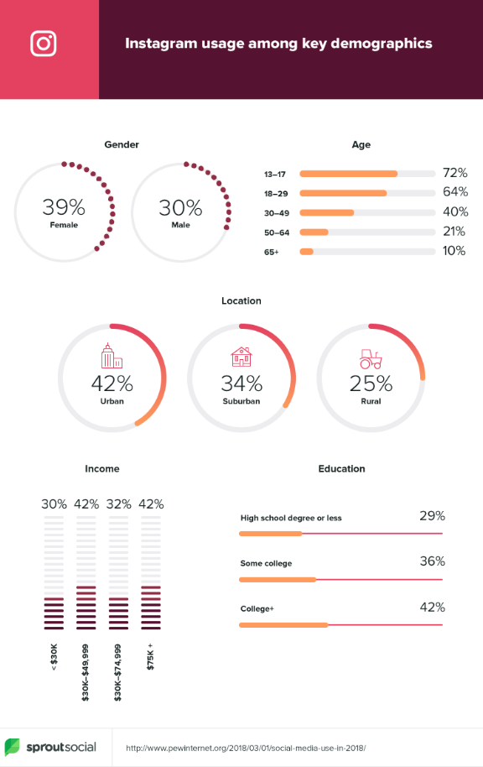
Instagram, the engagement winner (1bn users)
Engagement with brands on Instagram is 10x higher than Facebook
People are more interested in brands on Instagram
They’re seeking inspiration and new ideas
It’s a more creative and less defensive place than the drama of Facebook posts
80% of accounts follow a business

Slide 14
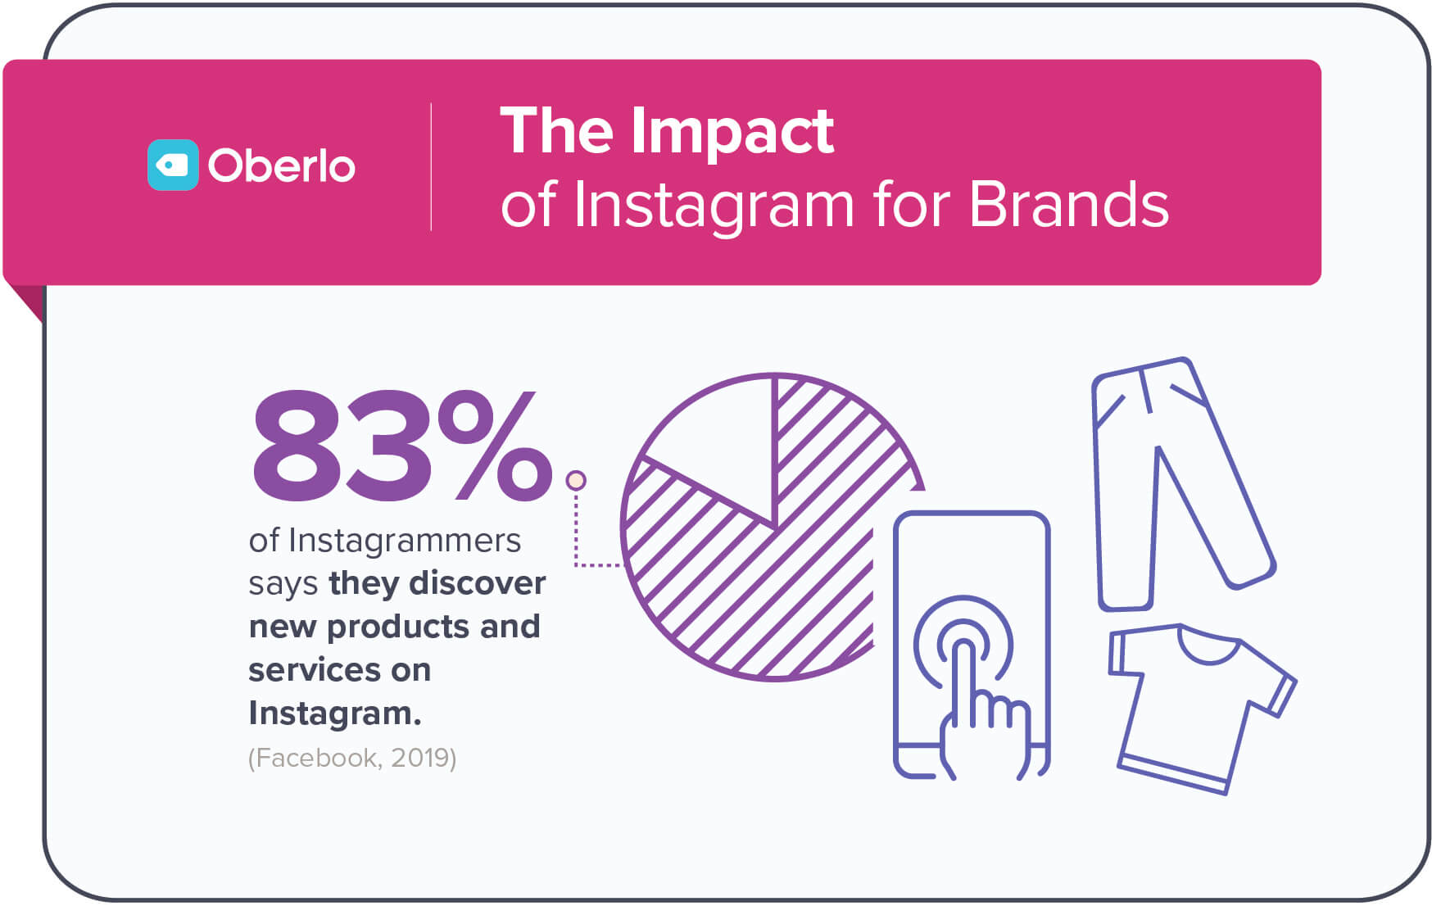
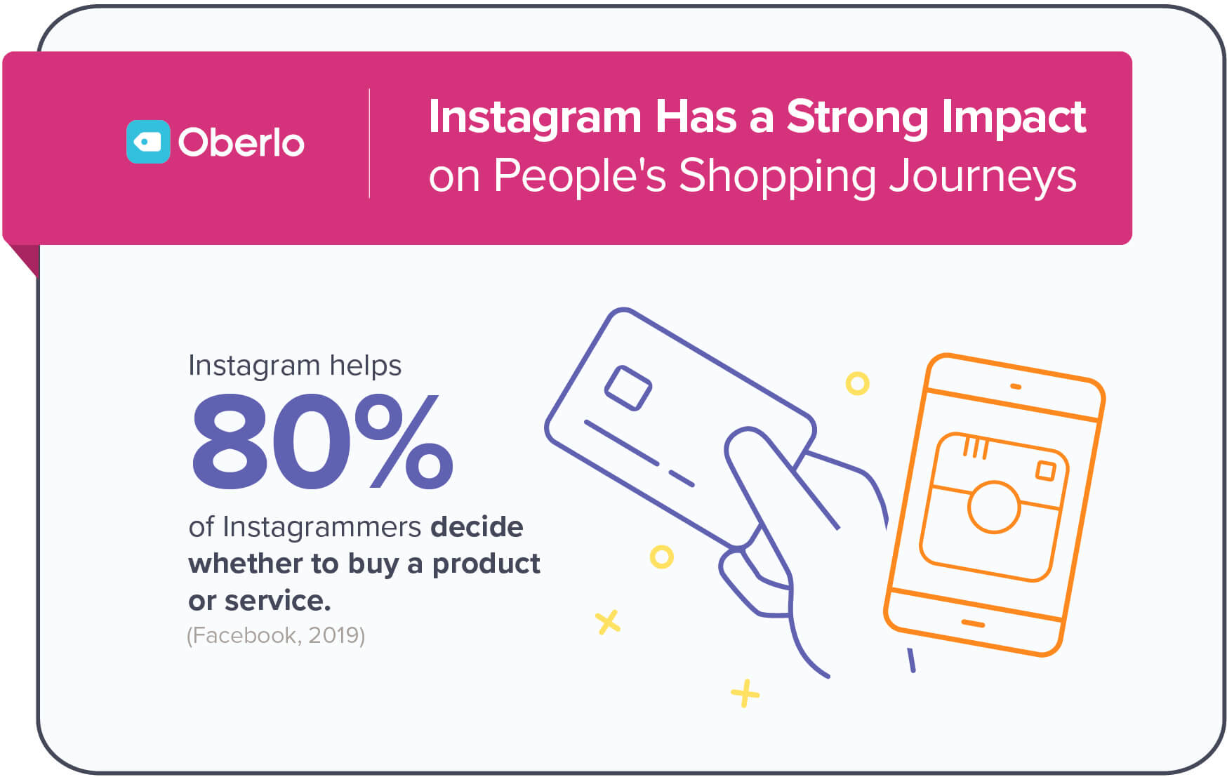
What does engagement mean for you?
User engagement on Instagram benefits your business by helping users make decisions about products and services they are interested in.

Slide 15
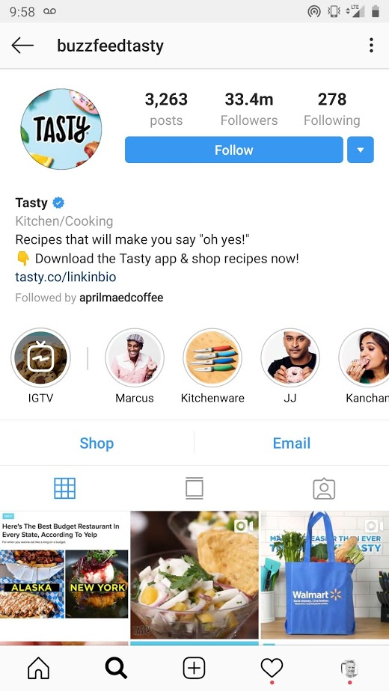
Tasty Instagram Presence
Call to action very prominent
Ability to shop and contact them at the top
Preview of posts includes 2 videos

Slide 16
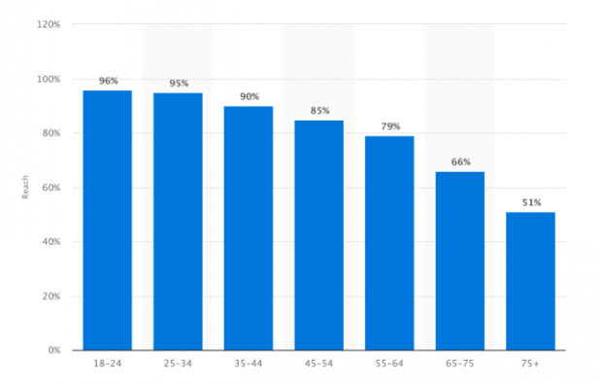
YouTube – not just cat videos! (1.9bn users)
Very high market penetration among all age groups
Traditional TV is on the decline and being replaced by online video (reaches 76% of 18-34 yr olds)
70% of millennials used YouTube watched a video to learn how to do something new.
Easy to share on social media, embed in websites
Notes:
Free hosting
Search engine optimized, because it’s owned by google, videos achieve higher ranking
Easy to optimize and tag for search
Videos are much easier to be viral
Integrated into popular mobile devices
Average person spends 60 min per mobile session on YouTube

Slide 17
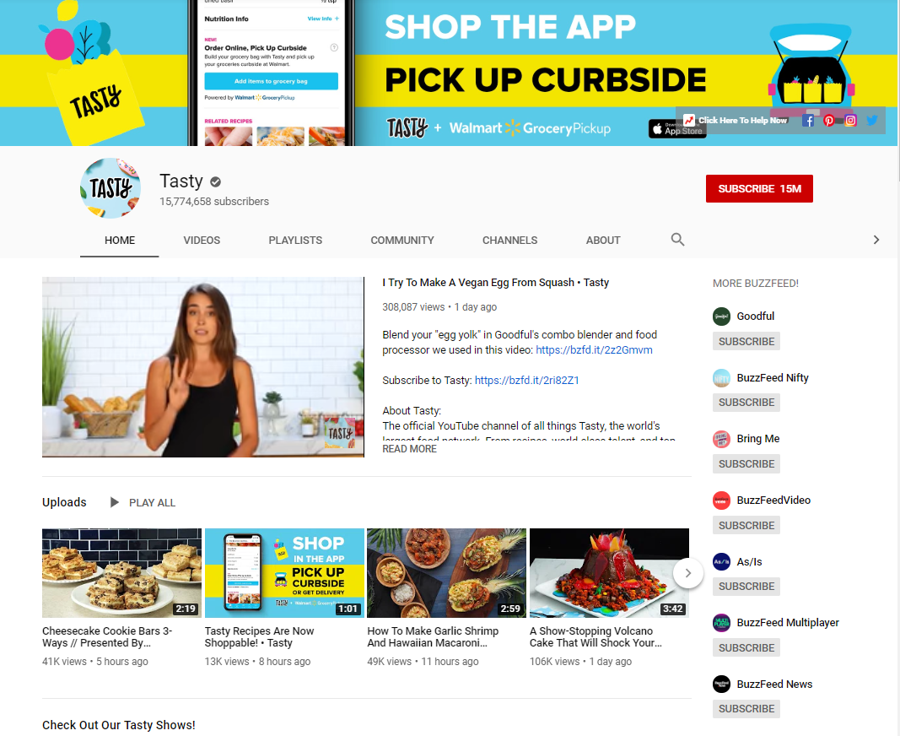
YouTube Channel
Automatically begins playing recent video
Consistent messaging in cover photo
Ability to communicate with Tasty on your favorite social network

Slide 18
Twitter (500mn users)
Growth is slowing – predicted to be 1% in the US
Users skew urban, educated and higher income
Tweets with video attract 10x as much engagement
Snapchat (300mn users)
Popular with younger generation – 71% under 35 years old
Most used social network for those under 24
Spend 25-30 minutes every day on the platform

Slide 19
LinkedIn (630mn users)
#1 for B2B Marketing
Accounts for 50% of trafface to B2B websites and blogs
Business focused platform
Pinterest (250mn users)
Reaches 83% of US women ages 25-54
High income and educated households are twice as likely to use
85% of women use pinterest to plan life moments (decorating, meals, gyms etc)

Slide 20
10 Tips for Developing your Marketing Strategy
1. Start with a cohesive message
What is your objective?
Know your target audience
Work smarter, not harder, listen to what others are saying

Slide 21
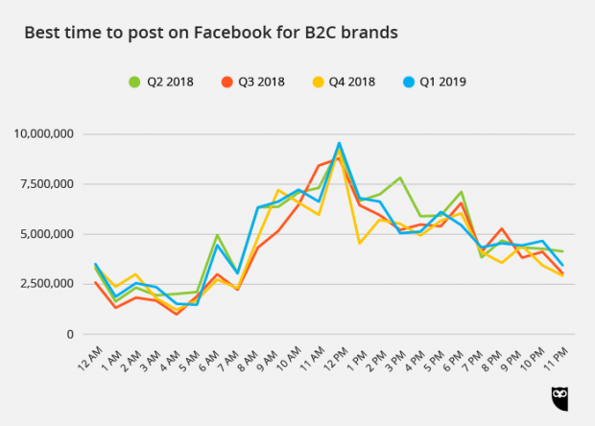
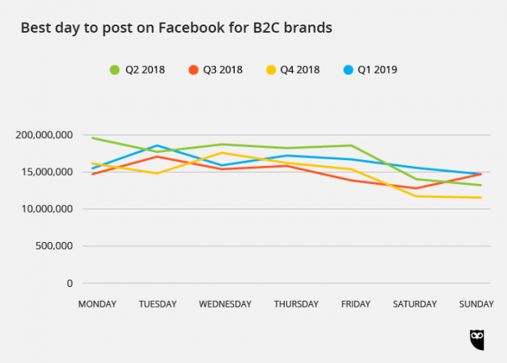
10 Tips for Developing your Marketing Strategy
2. Know when to post

Slide 22
10 Tips for Developing your Marketing Strategy
3. Use High Quality, Relevant Photos
Free stock photo resources: Pexels.com Pixabay.com
The Bad
Awkward, over-exaggerated emotions
Low Resolution and Pixelated
The Good
Realistic
Authentic, relevant and personalized

Slide 23
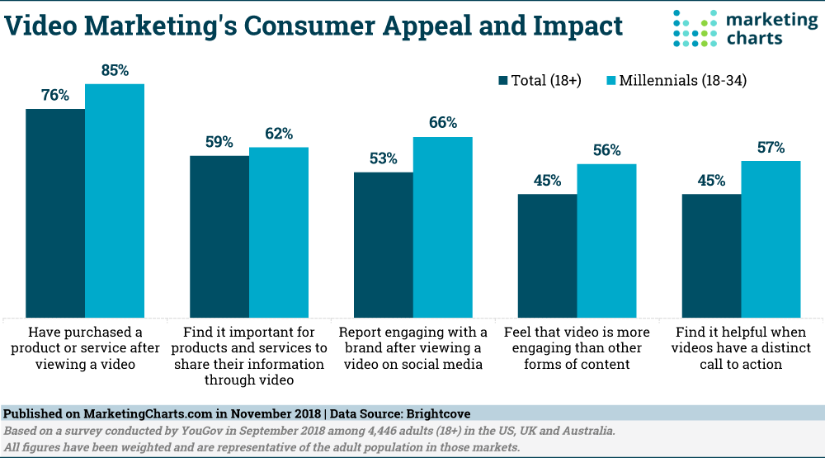
10 Tips for Developing your Marketing Strategy
4. Using Video

Slide 24
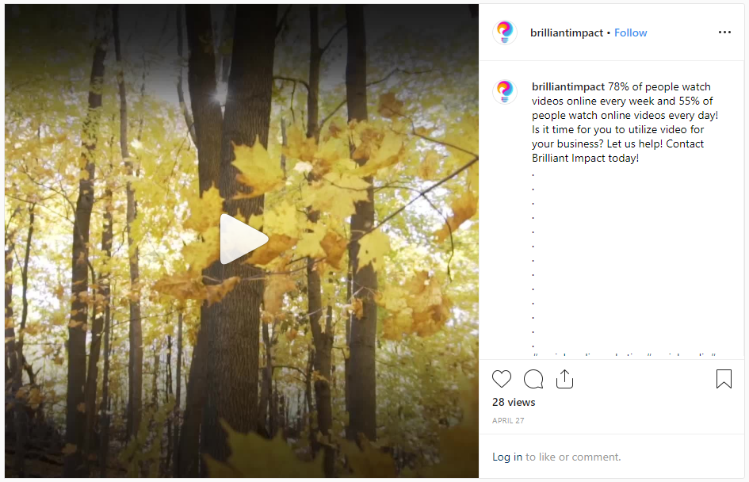
10 Tips for Developing your Marketing Strategy
4. Using Video
Examples: 30 second Instagram video

Slide 25
10 Tips for Developing your Marketing Strategy
5. Write great content
Post should 80% inform, educate or entertain with 20% directly promoting your brand
Be a trustworthy forum
Provide expert information
Be a good listener – what have people been asking about?
Think of it as a conversation, not marketing
Are you adding valuable information or making a sales pitch?

Slide 26
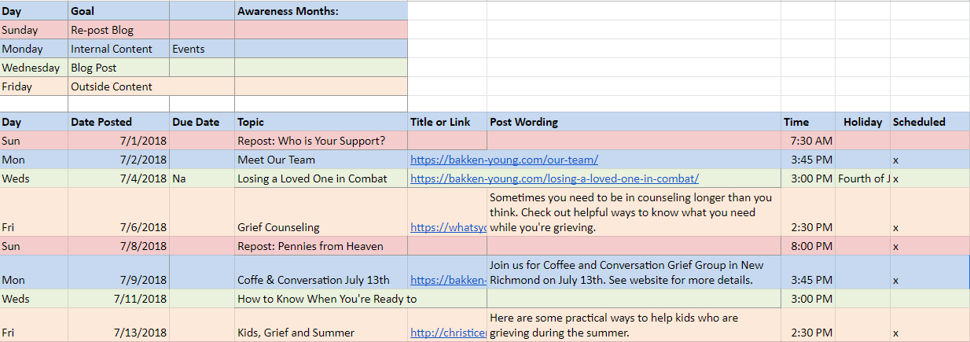
10 Tips for Developing your Marketing Strategy
6. Scheduling
Always have content prepared
Stay on message and plan overall strategy for the month

Slide 27
10 Tips for Developing your Marketing Strategy
7. Stories
“The Stories format is on a path to surpass feeds as the primary way people share things with their friends sometime next year” - Facebook CPO Chris Cox
Stories are growing 15x faster than feed based sharing

Slide 28
10 Tips for Developing your Marketing Strategy
8. Understanding your social channel and their unique traits
Instagram
Hashtags, Branded hashtags
Cannot embed links in posts
Facebook
Profile Vs. Page
Twitter
Character limitation on Tweets
Pinterest
Dimensions of the photos are very different from other social platforms

Slide 29
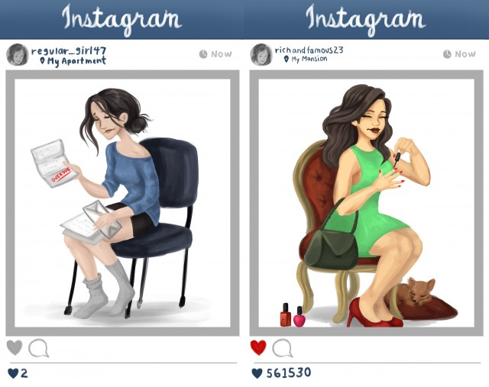
10 Tips for Developing your Marketing Strategy
9. Authenticity Matters
Create a history of reliability and authenticity. This is especially important for the Millennial and Gen-Z population.
Young adults know when someone is being dishonest or trying to sell a product to them.

Slide 30
10 Tips for Developing your Marketing Strategy
9. Authenticity Matters – Things to think about
Know the target audience and your objective, should never be about sales or yourself, always about the community members making their lives better
Listen to their wants
Keep content fresh and real

Slide 31
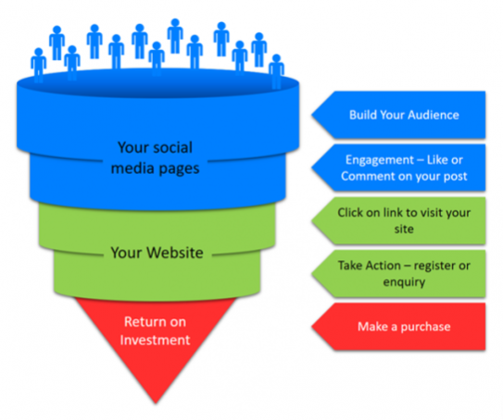
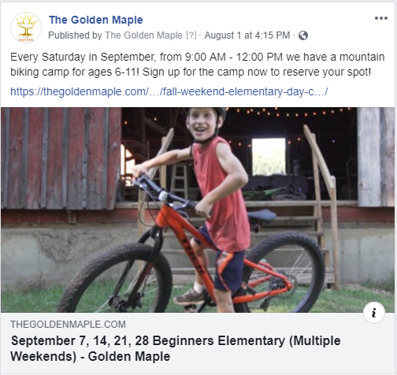
10 Tips for Developing your Marketing Strategy
10. Funnel users to website or other call to action

Slide 32
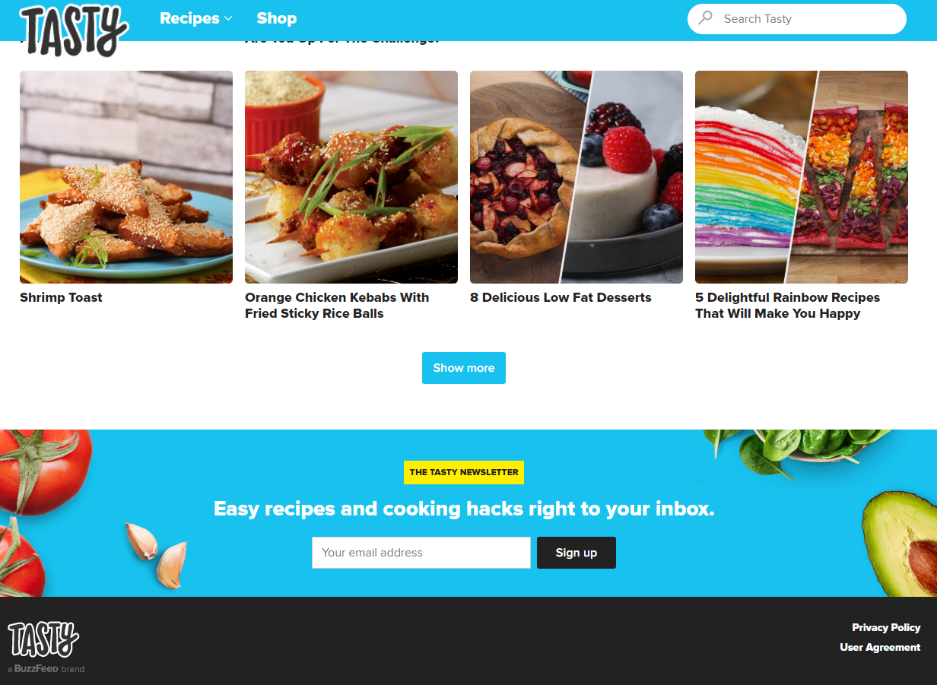
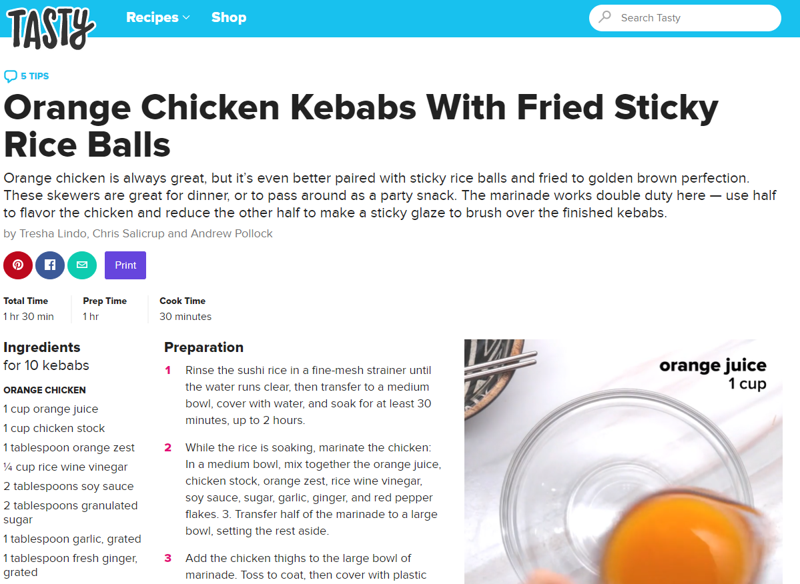
Website Integration Example
No Social Media Links on homepage
Gather user information through newsletter signup
Sharing available on recipe page
Video easily accessible

Slide 33
Taking your First step
Create unique content that reflects your business
Facebook account
Instagram account
Blog section on your website
Get the discussion started
Choose a medium and stick with it
Stay on message
Update weekly at minimum

Slide 34
Measuring your success
Page analytics
Sales
Amount of Followers
Website Page views
Search rankings
Media Mentions
Material Downloads
Community membership
Highly shared post, or media

Slide 35
Questions on Social Networking?

